Slide 1

How to approach and plan your investments and how to make them work for you
Cur8 Investor Club June 2024

Slide 2

The Cur8 Investor Club
From the point of singing up for the Cur8 platform you will be a member of an investment syndicate
After 6 months as a member of a syndicate you qualify to invest with Cur8 Capital as a sophisticated investor

Slide 3
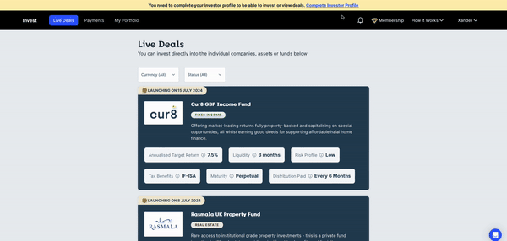
If you registered before 4th December 2024, you are now eligible to self-certify

Slide 4
This month
How to approach your investments
How to plan your investments
How to make them work for you

Slide 5
A Good Portfolio Meets Your Goals
There is no one size fits all
It depends on personal preference and risk tolerance
How are you willing to part ways with your money?
How much money you need and are willing to put into a high-risk investment?

Slide 6
Let’s look at some examples

Slide 7

Example 1 - Bilal
Goals:
Bilal is 25, and has £30,000 to invest thinking of buying a house
He is aiming to save £50,000 for deposit to buy a house in the next 3 years
Risk tolerance:
He will want to put in very low risk
He will want to put in something with liquidity to get his money out when it’s time to buy the house

Slide 8

Example 2 - Hamzah
Goals:
Hamzah is 30, has a mortgage and has £20k to invest
He wants to grow long term wealth
Risk tolerance:
Hamzah is relatively risk averse but still wants to see decent returns
Wants to have liquidity and access to his money
Solution:
Mix of stocks and shares (e.g ETF), real estate (Cur8) and fixed Income in a 50/25/25 split

Slide 9

Example 3 - Salman
Goals:
Salman is 40, owns his house, wants lucrative returns with £50k to invest
He wants large returns and can afford to invest in assets with long lock up periods
Risk tolerance:
Salman doesn't need steady income as he doesn’t have mortgage and earns a lot in his day job
Solution:
Private equity, venture capital, and stocks & shares.

Slide 10
Understanding your risk profile
Fixed Income - Safe, relatively liquid (3 months)
Real estate, - Safe, not as liquid (although we provide liquidity for Rasmala)
Stocks and shares - more low-med risk but has higher growth profile, instant access
Private Equity - long term investing, medium risk
Venture Capital - long term investing, high risk

Slide 11
Self-certification Walkthrough

Slide 12
Questions & Answers

