Slide 1

The Risks and Rewards of Investing
Cur8 Investor Club May 2024

Slide 2

The Cur8 Investor Club
From the point of singing up for the Cur8 platform you will be a member of an investment syndicate
After 6 months as a member of a syndicate you qualify to invest with Cur8 Capital as a sophisticated investor

Slide 3
This month
Three Golden Rules for investing
Finding your portfolio balance

Slide 4

Three Golden Rules
Balancing risk and reward in investment

Slide 5

Rule 1: Know why you’re investing
What are your goals? This will affect your appetite and exposure to risk
Is it so you can retire?
Is it to pay for your children at university
Is it to build wealth?
Is it to take a risk a build money quickly?

Slide 6
Rule 2: Stick to your risk limits
Low Risk
You can’t really afford to lose this money, you need it quite soon for something quite important e.g., a house deposit or tuition fees, and you’re happy with relatively low returns of 1-3%
Medium Risk
You can afford to see a little volatility in your investments in exchange for a higher return (3-10%). But again, you certainly don't want to lose your money in the long-run.
High Risk
You are focused on seeing the best returns possible and are willing to lose a lot of your money if things go wrong, so that you have a chance of making a lot of money (returns of >10%] if things go right.
You can stomach seeing plenty of volatility.

Slide 7

Rule 3: Diversify
Don’t put all your eggs in one basket
Regardless of what kind of portfolio you are creating, it is always good to have variety to smooth over the big ups and downs.
Within each asset class you should look to diversity further if you can.

Slide 8
What do risk levels mean?
HIGH RISK
MEDIUM RISK
LOW RISK
Usually means lower
fluctuations,
unlikely to lose all your money and returns between
0.5 – 5%
Usually means moderate fluctuations, and returns between 3 – 10%
Usually means high fluctuations, the possibility of losing all your money and returns
10+%

Slide 9
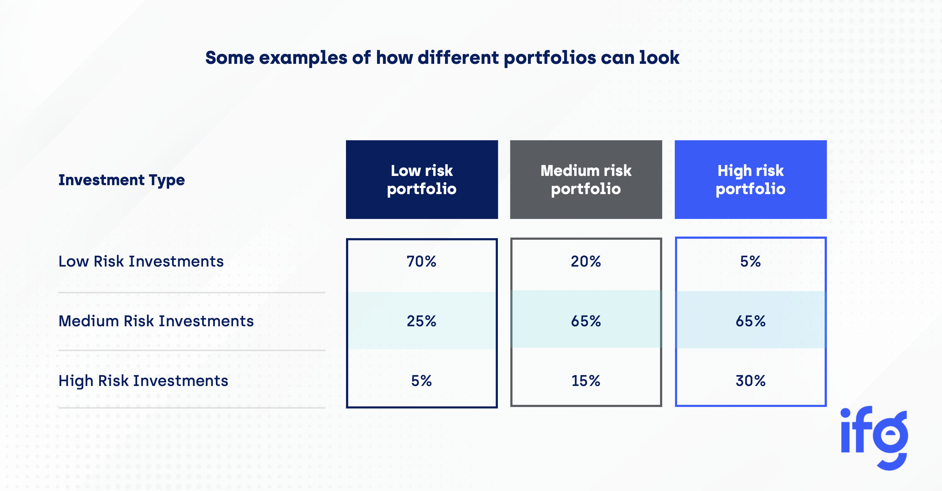

Slide 10
Some types of investments
Low Risk
Pensions
Fixed Income
Medium Risk
Stocks and Shares
Property (buy to let and refurbishment)
DIY Investing
High Risk
AIM portfolio
SME Finance
Property Development
Venture capital
Crypto

Slide 11
Some of Cur8’s Options

Slide 12







Low Risk
Medium Risk
High Risk

Slide 13
Questions & Answers

